Slide 1
Interprocess Communication , RPC, and Messaging
Inter-process Communication
Frank Walsh
Richard Frisby

Slide 2
Agenda
Interprocess Communication
IP Protocols
External Data Representation
Remote Invocation
Request/Reply protocols
Remote Procedure Call
Remote Method Invocation
Indirect messaging
Group Communication
Publish/Subscribe
Queueing

Slide 3
Interprocess Communication
Applications
Remote invocation, indirect communication
Middleware
Underlying interprocess communication primitives:
layers
Sockets, message passing, multicast support, overlay networks
UDP and TCP

Slide 4
TCP/UDP
Already covered TCP/UDP
UPD
One way stream
transmit a single message to a receiving process
Messages contained in Datagrams
TCP
Two way stream between pairs of processes
Streams provides basis of Producer-Consumer relationship
Pair of processes make up Producer-consumer relationship
Data items sent by producer normally queued at receiving host until consumer is ready to receive

Slide 5
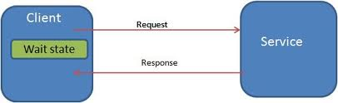
Interprocess Communication Characteristics
Consider initially communication between 2 processes connected by a network.
2 message sending operations:
Send and Receive
Message sending may involve synchronising of the two processes:
E.g. process1 sends message to process2 and waits until process2 responds before doing anything else
Real world example???

Slide 6
Synchronous and Asynchronous communication
Sending and receiving processes may be either synchronous or asynchronous
Synchronous form of communication:
the sending and receiving processes synchronise at every message
Asynchronous form of communication:
Sender can send to receiver without waiting for receiver process to be ready
Buffering usually required
Sender and receiver processes can ‘overlap’

Slide 7
Synchronous Pros/Cons
Pros:
simpler in that there is a synchronisation point between sender and receiver on message transfer
no buffering is required. Sender will not continue until the receiver is ready
Cons:
Sender has to wait for receiver to be “ready” before sending
Can halt execution of processes

Slide 8
Asynchronous Pros/Cons
Pros:
Can deliver a message from sender to receiver, without waiting for the receiver to be ready.
Sender and receiver can overlap their computation because they do not wait for each other.
Cons:
Can be more complex to implement/manage(e.g. use of buffers/threads etc.)
Buffers can cause problems when they are full.

Slide 9
Message Destinations and Addressing
As already covered, Internet protocols use IP address/port pair
Sending a message to a IP/port:
IP address is message address on network
port can be thought of as a message destination in the computer
Port can have one process listening
Any process may make use of multiple ports to receive messages
A process cannot share ports with other processes on the same computer
Any process can send a message to any port

Slide 10
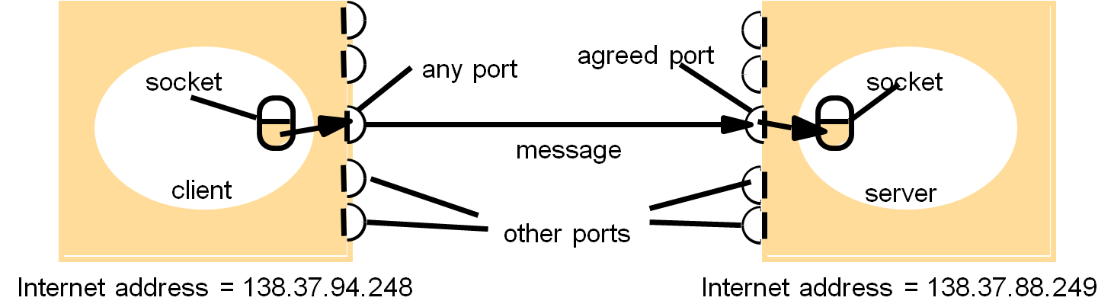
Sockets
UDP and TCP use sockets.
Interprocess communication consists of transmitting a message between a socket in one process and a socket in another process.
A receiving process must have it’s socket bound to a local port and one of the Internet addresses of the computer on which it runs.
Each socket is associated with a particular protocol – either UDP or TCP

Slide 11
UDP communication
Transmitted without acknowledgement or retries
Failure Models:
Messages may be dropped occasionally. Can be regarded as omission failures in the communication channel.
Ordering: Messages can sometimes be delivered out of sender order.
Applications must provide their own checks to achieve reliable communication
No overheads associated with guaranteed message delivery
Attractive choice for applications that do not need reliable delivery

Slide 12
TCP Communication
When establishing a connection
one process is the client, the other the server
thereafter they can be peers.
Failure Model:
Uses checksum to correct/reject corrupt packets
Use of timeouts and retransmissions to deal with lost packets
Does not guarantee reliable delivery
If timeout or link broken, TCP connection will be broken also.
Processes cannot distinguish network or process failure as reason for broken connection. Cannot tell if the message has been received or not...

Slide 13


TCP Communication
Uses of TCP
HTTP
FTP
SMTP

Slide 14
External Data Representation
Information in processes/programs held in Data Structures
E.g Array of Strings , Object instances,
For one program to transmit information to another across a network, the corresponding data structure must be “flattened”
converted to a sequence of bytes before transmission and then rebuilt
Sort of analogous to getting an ice cube through a funnel.
Turn the ice cube to water
Pass it through the funnel
Reconstruct the ice cube(freeze the water again)
How do you reconstruct the ice cube with exactly the same dimensions?

Slide 15
External Data Representation
To pass data across a channel between two computers:
values are converted to an agreed external format before transmission. Values converted to the local form on receipt
The values are transmitted in the sender’s format, together with an indication of the format used, and the recipient converts the values if necessary
An agreed standard for the representation of data structures and primitive values is called an external data representation

Slide 16
External Data Representation
Marshalling
the process of taking a collection of data items and assembling them into a form suitable for transmission in a message
Unmarshalling
The reverse of above
Next we’ll look at 3 external data representation machanisms
Java Object Serialisation
XML
JSON

Slide 17
External Data Representation Java object Serialisation
Take the following example Java class
public class Person implements Serializable {
private String name;
private String place;
private int year;
public Person(String aName, String aPlace, int aYear) {
name = aName;
place = aPlace;
year = aYear;
}
// followed by methods for accessing the instance variables
}
Stating that a class implements the Serializable interface means that objects of can be “flattened” for transmission/storage

Slide 18
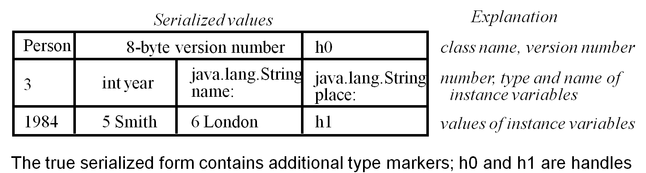
Java Object Serialisation/Deserialisation
Serialization is the activity of flattening an object or a connected set of objects into a serial form.
Deserialization consists of restoring the state of an object or a set of objects.
In the serialization process, class type information is also serialised so that the recipient can load the appropriate class when an object is deserialized
Above figure illustrates serialised form of following:
Person p = new Person("Smith", "London", 1984);

Slide 19
External Data Representation XML
eXtensible Markup Language(XML)
Same heritage as HTML(but XML is NOT HTML)
XML data items are tagged with ‘markup’ strings
used to describe the logical structure of the data
XML has many uses(as you will see later). For now we confine ourselves to external data representations
Has many cool features including
Extensible
Textual
Kind of human readable and machine readable...

Slide 20
XML
namespace
<person id="123456789">
<name>Smith</name>
<place>London</place>
<year>1984</year>
<!-- a comment -->
</person >
<person pers:id="123456789" xmlns:pers = "http://www.cdk5.net/person">
<pers:name> Smith </pers:name>
<pers:place> London </pers:place >
<pers:year> 1984 </pers:year>
</person>
Above shows XML definitions of the Person structure.
As with xHTML, tags enclose character data.
Tags : <name>, <place>,<year> data:”Smith”, “London”…
Namespaces provide a means for scoping names
Check out XML resources on Moodle for a more detailed description

Slide 21
External Data Representation JSON
JavaScript Object Notation
Lightweight text-based open standard designed for human readable data interchange.
Can represent simple data structures and associative arrays.
Good for serializing and transmitting structured data across a network

Slide 22
JSON
{ person:{ id:123456789, name:'Smith', place:'London', year:1984 } }
JSON is often used in Ajax techniques
Often seen as low overhead alternative to XML
Application programming interfaces(APIs) exist for most programming languages

Slide 23
Object Serialisation vs. XML vs. JSON
Java Object Serialisation includes full information about the types of its contents.
Allows receiver to reconstruct objects. However, receiver (usually) needs to be a Java program and needs access to class types.
XML can include type information(using XML schema)
XML designed to be “platform independent”, open standard
most programming languages, including Java, provide processors for translating between XML and language-level objects
JSON
More straight forward than XML
In XML, same data can be represented several ways(example in class) <person id=“123456779” name=“smith” place=“london” year=“1984” /> Same representation in JSON
JSON has one straight forward way

Slide 24
Remote Invocation
Applications
Remote invocation, indirect communication
Middleware
Underlying interprocess communication primitives:
layers
Sockets, message passing, multicast support, overlay networks
UDP and TCP

Slide 25
Remote Invocation
Two separate processes on different computers.
How does the program on computer 1 get the program on computer 2 to do something.
Example – Mobile Phone Billing application
Common practice that monthly usage bills notification via SMS.
Process on computer 1 (Billing application) wants to send notification SMS that this months bill is available to view online
Process on computer 2 (texting service) can send texts
Computer 1 remotely invokes “sendText()” operation on computer 2, passing required parameters (mob. No. , message text)

Slide 26
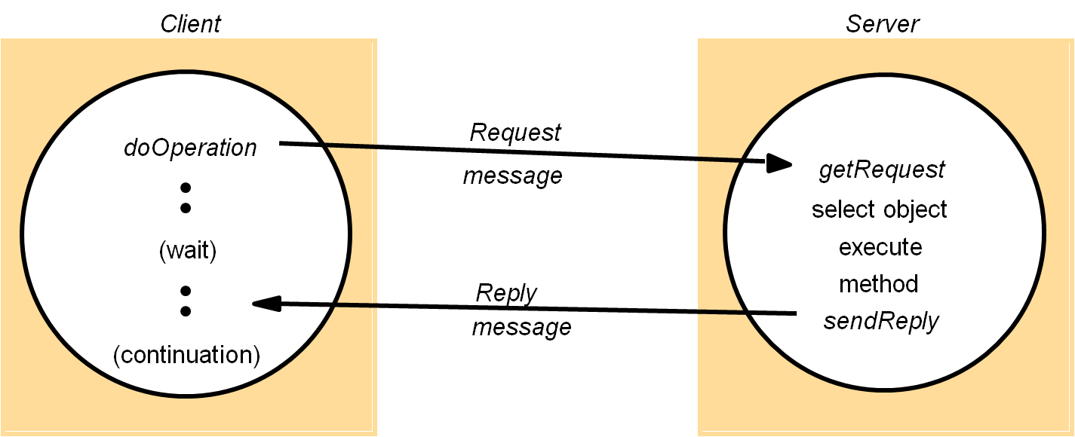
Request-Reply protocols
Typical in most client server applications
Can be both synchronous and Asynchonous
If client can’t go on without reply – synchronous
Acknowledgements are not needed - reply acts an acknowledgement

Slide 27
Request Reply protocols
If we were to use Request-Reply protocol for the Sending SMS operation described earlier.
public byte[] doOperation (RemoteRef s, int operationId, byte[] arguments)
sends a request message to the remote server and returns the reply.
The arguments specify the remote server(s), the operation to be invoked(operationId)
and the arguments of that operation(in this case, the mob. Number and Text Message.)
public byte[] getRequest ();
acquires a client request via the server port.
public void sendReply (byte[] reply, InetAddress clientHost, int clientPort);
sends the reply message reply to the client at its Internet address and port.

Slide 28
Request-Reply Protocol
Three typical protocol formats
Request
a single Request message is sent by the client to the server
no value to be returned from the remote operation
client may proceed immediately after the request message is sent
Request-Reply
As discussed above
Delivery failures may occur if UDP is used
What if operation is not idempotent?(example CC payment procedure at Orange PCS 2004)
Request-Reply-Acknowledge Reply
Same as RR. In addition, client sends Ack. Reply back to server with replyID.

Slide 29
HTTP
HTTP involves request-reply exchange
Supports fixed set of methods(GET, PUT, POST...)
Unlike previous example where server has own set of operations
More about this later in REST
Covered this previously so wont repeat it – reference in Moodle

Slide 30
Remote Procedure Call
RPC is fundamental technique in Distributed Systems
Abstraction of operation/procedure call to the Distributed environment
Procedures on remote machines can be called as if they are procedures in the local machine
Many implementations of RPC exist
We’ll see one soon in Web Services

Slide 31
Using RPC
RPC requires definition and use of interfaces
Programming with Interfaces
explicit interface is defined for each module/process/service
All we know about a service is what’s exposed though the interface
Implementation can change but no problem to clients as long as interface remains the same
Interfaces in Distributed Systems
Servers make programs visible via “Service Interfaces”
Service interfaces specify remote procedures on offer to clients
Developers only concerned with what it does, not how it does it (Example: do you really know/care how Google provides search results)
Developers need not be concerned about the programming language /platform used to implement a service they need.

Slide 32
Interface Definition Languages
RPC integrated into programming environment using Interface Definition Languages(IDLs)
IDL must include all specifics necessary to map to pragramming language such as IO paramater types.
Heterogeneous nature of Dist. Systems: C#, Java , PHP, etc.
beneficial to allow programs written in a variety of languages to access each other remotely
IDLs are designed to promote this...
Commonly used IDLs:
CORBA IDL
Web Service Description Language

Slide 33
IDLs - CORBA example
struct Person {
string name;
string place;
long year;
} ;
interface PersonList {
readonly attribute string listname;
void addPerson(in Person p) ;
void getPerson(in string name, out Person p);
long number();
};
CORBA has a struct
remote interface
remote interface defines methods for RMI
parameters are in, out or inout
Remote interface:
specifies the methods of an object available for remote invocation
an interface definition language (or IDL) is used to specify remote interfaces. E.g. the above in CORBA IDL.
Java RMI would have a class for Person, but CORBA has a struct
•
Notes:
Person structure (type used in arguments in the interface)
in Java RMI it would have been defined as a class
But CORBA may be used by non object-oriented languages e.g. C that don’t have classes.
interface PersonList specifies methods available for RMI
note in and out on parameters
note attribute - really like another method, can get the value from it

Slide 34
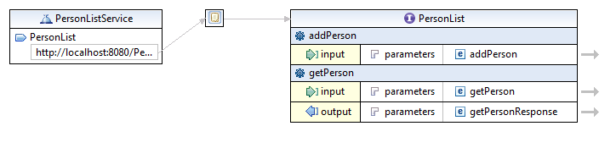
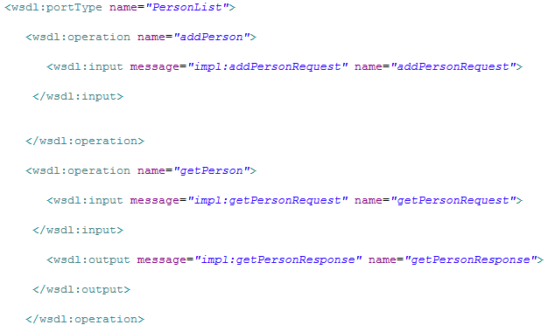
IDLs - WSDL

Slide 35
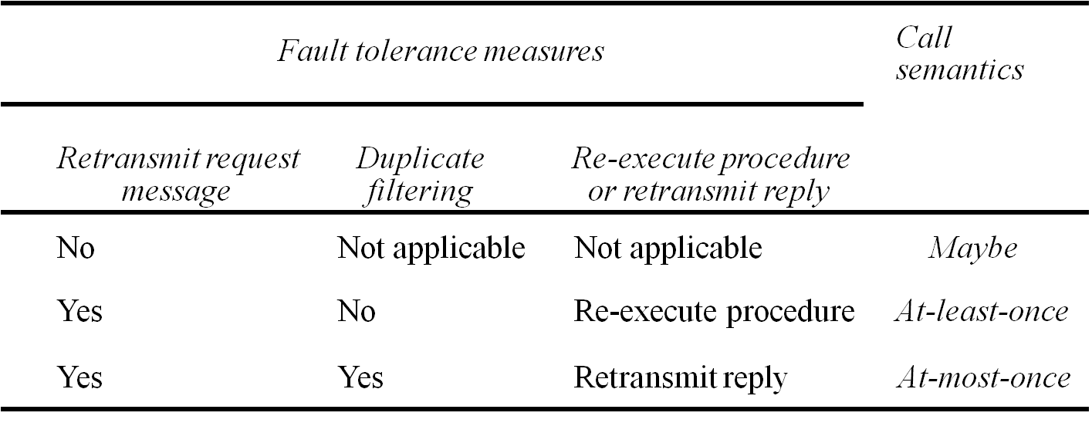
RPC Semantics & Fault Tolerance
Maybe Semantics
Remote procedure “might” be executed
Uncertain if procedure has been executed(request lost, server crash, reply lost)
At-least-once semantics
caller retransmits until result or no result exception
Venerable to crash failure on server
Not suitable for non-idempotent operations
At most once
Caller receives result or no result exception
Implements all above fault tolerance measures

Slide 36
RPC Implementation
client process
server process
Request
Reply
client stub
server stub
procedure
procedure
client
service
program
Communication
Communication
procedure
module
module
dispatcher
General RPC architecture over Request-Reply protocol

Slide 37
Indirect Messaging

Slide 38
Using the “Middleman”
Communication between processes using an intermediary
Sender → “The middle-man” → Receiver
No direct coupling
Up to now, only considered Direct Coupling
Introduces a degree of rigidity
Consider…
What happens if client or server fails during communication in Direct Coupling?
Two important properties of intermediary in communication
Space uncoupling
Time uncoupling

Slide 39
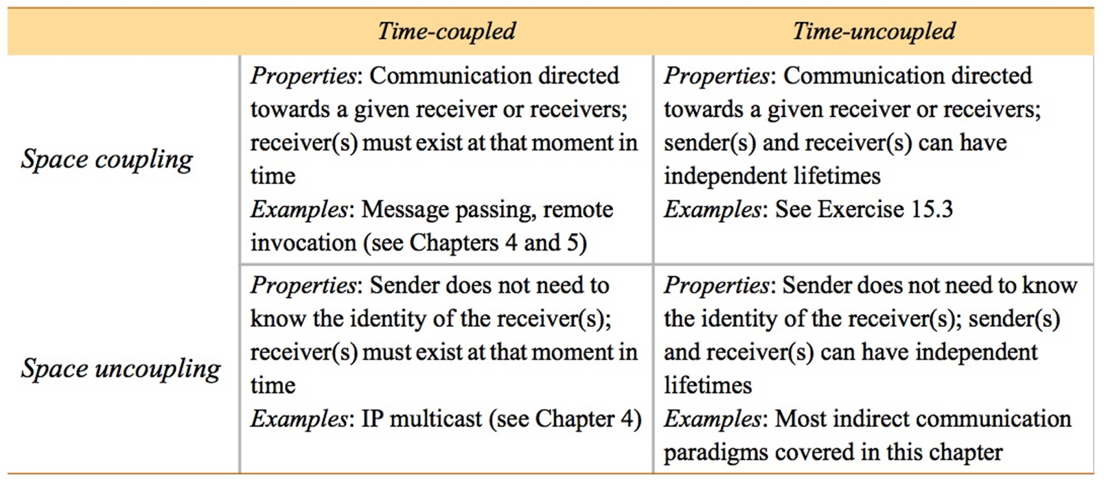
Space and Time uncoupling
Instructor’s Guide for Coulouris, Dollimore, Kindberg and Blair, Distributed Systems: Concepts and Design Edn. 5 © Pearson Education 2012

Slide 40
Time uncoupling vs. Asynchronous Comms
Asynchronous communication
sender sends a message and then continues
No need to meet in time with receiver
Message buffered at receiver
Time uncoupling
sender and receiver(s) can have independent existences
Receiver may not exist at the time communication is initiated

Slide 41
Group Communication
Message is sent to a group
Message is delivered to all members of the group
Sender NOT aware of receiver identities
Abstraction over multicast communication
Adds group membership, reliability, ordering
Advantages:
reliable dissemination of information to potentially large numbers of clients
support for collaborative applications(online gaming)
range of fault-tolerance strategies
support for system monitoring and management,
Programming model:
aGroup.send(aMessage)

Slide 42
Group Communication
Group is closed if only members of the group may multicast to it.
Example: coorperating servers
Open group allows outside processes communicate
Example: delivering external events to interested groups(sensor data)

Slide 43
Publish-Subscribe
Most widely used of all the indirect communication techniques
Usually event based
Event published somewhere – pickup up by all subscribers
Examples:
financial information systems
live feeds
ubiquitous computing(e.g. location events)
monitoring applications

Slide 44
Publish-Subscribe
Dealer’s computer
External
Dealer’s computer
source
Dealer
Notification
Notification
Dealer
Notification
Information
Notification
provider
Notification
Notification
Notification
Dealer’s computer
Dealer’s computer
Notification
Information
provider
Notification
Notification
Dealer
Dealer
External
source
Publish-Subscribe: Dealing room system

Slide 45
Publish – Subscribe
Publish-subscribe characteristics:
Heterogeneity: distributed system that were not designed to interoperate can be made to work together
Example: Android based mobile device publishes location info. Smart home agent subscriber picks up events and acts accordingly(e.g. turn on heating when user gets home)
Asynchronicity: Notifications are sent asynchronously to all subscribers – subscribers decoupled from publisher
Example: subscriber can be a queue for a particular process. Queue is accessed by process as and when it can(could be busy at time of notification).

Slide 46
Publish-Subscribe approaches
Channel based:
publishers publish events to named channels. Subscribers subscribe and receive all events.
Topic based
Each event associated with a “topic” or subject. Subscribers subscribe to a topic and recieve only topic events
Content based
Similar to Topic based. Subscription based on range of event attributes. For example, subscriber might specify author attribute is “Fintan OToole” and category is “Finance”

Slide 47
Publish-Subscribe Example Amazon Simple Notification Service(SNS)
Scalable and flexible publish-subscribe cloud based service
Topic-based approach
A topic is an “access point” – identifying a specific subject or event type – for publishing messages and allowing clients to subscribe for notifications
Topic policies
Can limit who can publish messages or subscribe
specifying notification protocols(i.e. HTTP/HTTPS, email, SMS, SQS)
Fairly Simple API for developers
CreateTopic, Subscribe, Publish
SDKs for all mainstream languages(Java, PHP, c# etc.)
More in labs....

Slide 48
Message Queues
Publish-Subscribe is one to many
Distributed Message Queues is point to point
Distributes Message Queues often referred to as Message orientated Middleware(MOM)
Examples
MQ Series
MS MQMS
Java Messaging Service

Slide 49
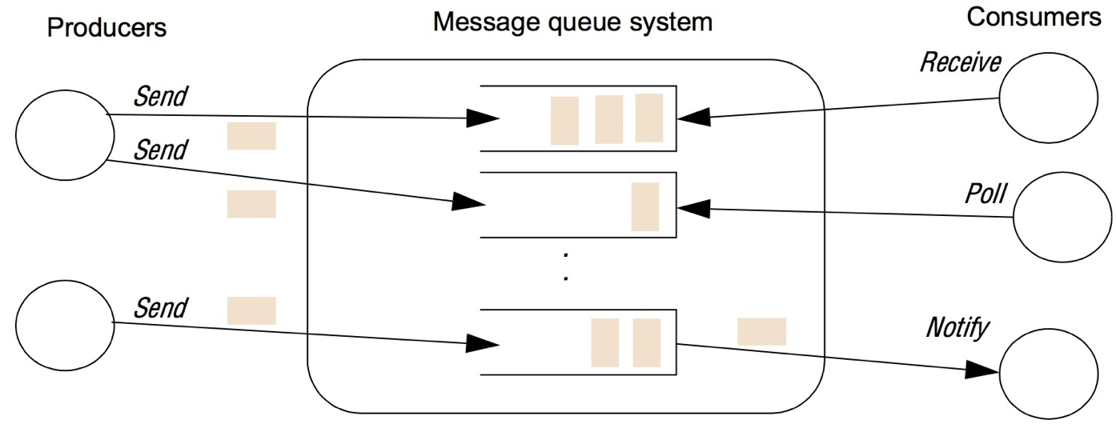
Message Queue
Queues operate First in First out (FIFO)
Modes of operation: Receive, Poll, Notify

Slide 50
Message Queue Applications
Messages are persistent
Stored until consumed(although possible to set “time to live”)
Supports reliable communication:
any message sent eventually received (validity)
message received is identical to the one sent
no messages are delivered twice (integrity)
Can be used in conjunction with other middleware to implement transactions
Ensure all the steps in a transaction are completed, or the transaction has no effect at all (‘all or nothing’)
Message Transformation
To support heterogeneity, transform messages between formats

Slide 51
Message Queues vs. Buffers
Queues similar to buffers mentioned earlier in asynchronous message passing communications
Buffers are implicitly associated with processes.
If the process goes down, the buffer will probably go down – no communication...
Message queues are separate, third party, entities in the distributed system.
Receiving process can go down but queue will stay alive, keep queuing messages
Queues facilitate for uncoupled, indirect comms.

Slide 52
Summary

Slide 53
References
Coulouris, Dollimore, Kindberg and Blair, Distributed Systems: Concepts and Design Edn. 5 © Pearson Education 2012
Lesson: All About Sockets : http://docs.oracle.com/javase/tutorial/networking/sockets/
Amazon Web Services, SQS: http://aws.amazon.com/sqs/

